Slide 1
Module 5 Physical Design and Governance of Data Warehouses
Lesson 3: Big data issues
Notes:
Welcome to Lesson 3 of Module 5 on Physical Design and Governance of Data Warehouses
Opening question
What dimension of big data is most important for physical design of data warehouses?Why do storage vendors use base 10 units instead of base 2 units for storage capacities?

Slide 2
Lesson Objectives
Provide definitions of big data
Discuss dimensions of big data
Define units of big data with examples
Reflect on value areas for big data
Notes:
Lesson 3 covers the definition, dimensions, sources, and impacts of big data on organizations
Objectives:
Recite the definition of big data
Discuss characteristics of big data
Identify the units of big data
List sources and examples of big data
Identify value areas for big data

Slide 3
Big Data Definitions
Doug Laney (2001)
“E-commerce, in particular, has exploded data management challenges along three dimensions: volume, velocity and variety.”
McKinsey Global Institute (2011)
“datasets whose size is beyond the typical ability of database software to capture, store, and analyze”
John Akred, Founder, Silicon Valley Data Science
“ “Big Data” refers to a combination of an approach to informing decision making with analytical insight derived from data, and a set of enabling technologies that enable that insight to be economically derived from at times very large, diverse sources of data.”
Notes:
http://blogs.gartner.com/doug-laney/deja-vvvue-others-claiming-gartners-volume-velocity-variety-construct-for-big-data/
https://datascience.berkeley.edu/what-is-big-data/
The phenomenon of explosive data growth known as big data was first stated by Doug Laney of the Meta Group in 2001. According to Laney’s report, big data contains three dimensions: volume (amount of data), velocity (rate of generating and processing data), and variety (type of data especially the distinction between structured and unstructured data). Most attention is focused on data volumes but the other two dimensions must be managed effectively to deal with problems of big data. Complementing the dimensions of big data, the McKinsey Global Institute defines big data as “datasets whose size is beyond the ability of typical database software to capture, store, manage, and analyze.” This definition provides flexibility to vary volumes considered as big data by technology, industry sector, and time.
John Akred, Founder and CTO, Silicon Valley Data Science External link
“Big Data” refers to a combination of an approach to informing decision making with analytical insight derived from data, and a set of enabling technologies that enable that insight to be economically derived from at times very large, diverse sources of data. Advances in sensing technologies, the digitization of commerce and communications, and the advent and growth in social media are a few of the trends which have created the opportunity to use large scale, fine grained data to understand systems, behavior and commerce; while innovation in technology makes it viable economically to use that information to inform decisions and improve outcomes.

Slide 4
Big Data Timeline
NASA paper
How much information?
2000
Laney report
2001
How much information?
2003
Government funding essay
2008
1997
Google MapReduce
Hadoop
2004
2005
Hadoop 2
2013
Notes:
http://dl.acm.org/citation.cfm?id=266989&picked=prox&cfid=605590250&cftoken=67419935
Overlap with Hadoop history
NASA 1997 paper: VIS '97 Proceedings of the 8th conference on Visualization '97
Application-controlled demand paging for out-of-core visualization
First documented use of the term “big data”
Data sets are generally quite large, taxing the capacities of main memory, local disk, and even remote disk.
Laney, Doug, “3D Data Management: Controlling Data Volume, Velocity and Variety,” META Group (now Gartner), February 2001.
Coined term “big data”
Defined key data management challenges: Volume, variety, and velocity
Hal Varian, UC Berkeley, “How much information 2000”
http://www2.sims.berkeley.edu/research/projects/how-much-info/
1999 estimate: 1.5 exabytes (1.5 billion gigabytes) per year
2002 estimate: 3.0 exabytes (3.0 billion gigabytes) per year
The world produces between 1 and 2 exabytes of unique information per year, which is roughly 250 megabytes for every man, woman, and child on earth. An exabyte is a billion gigabytes, or 10¹⁸ bytes.
MapReduce
Google paper in OSDI 2004: “MapReduce: Simplied Data Processing on Large Clusters”
Google had utilized MapReduce for several years.
Hadoop
Created by Doug Cutting (Yahoo) and Mike Cafarella in 2005 although work started in 2002
Took a number of years after 2005 to achieve real usability
Hadoop history: https://gigaom.com/2013/03/04/the-history-of-hadoop-from-4-nodes-to-the-future-of-data/
Substantial upgrade in 2013 with Hadoop 2
Big-Data Computing: Creating revolutionary breakthroughs in commerce, science, and society, Dec. 2008, Bryant, R., Katz, R., and Lazowska, E.
Popularized big data term
Recommendation for increased government funding for NSF, DARPA, DOD, and DOE
Increased investment in network infrastructure
Widely quoted big data study by McKinsey (2011)
Definitional challenge
“this definition is intentionally subjective and incorporates a moving definition of how big a dataset needs to be in order to be considered big data.”
http://www.forbes.com/sites/gilpress/2014/09/03/12-big-data-definitions-whats-yours/

Slide 5
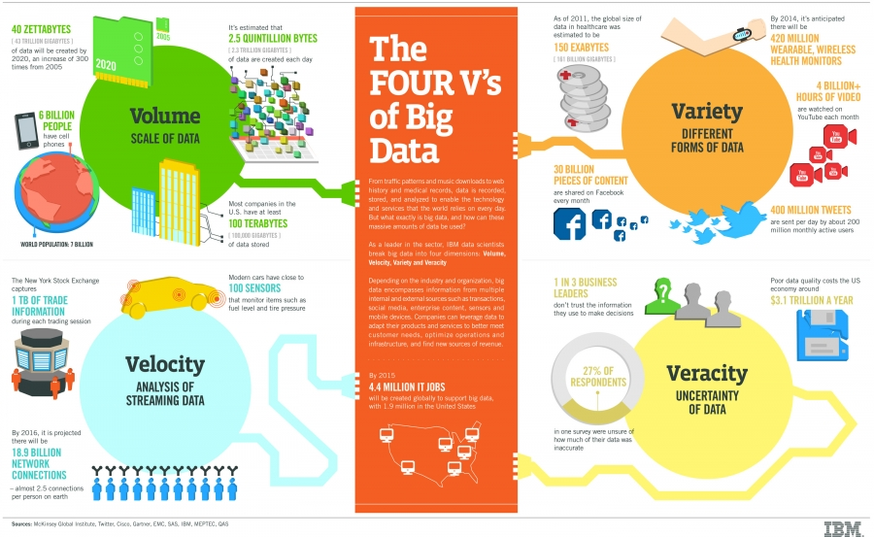
IBM Big Data Dimensions
Notes:
From: http://www.ibmbigdatahub.com/infographic/four-vs-big-data
A fourth dimension of big data has also been defined by IBM; veracity, the uncertainty of data. This helps to explain the percent of business leaders and consumers who don’t trust data and the expense on the US economy of poor data quality.
According to a NewVantage Partners survey in 2012 conducted on more than 50 large companies, the variety of big data gathered is more important than the volume. “The important goal and potential reward of Big Data initiatives is the ability to analyze diverse data sources and new data types, not managing very large data sets.”

Slide 6



Sources of Big Data
Notes:
The growth in data comes from a variety of sources including sensors in devices such as smart phones, energy meters, and automobiles, interaction of individuals in social media websites, radio frequency identification tags in retail, and digitized multimedia content especially high definition video. This data growth breaks existing systems and business processes providing challenges and opportunities for both vendors developing database technology and organizations using database technology.
Big data examples
700 million websites, 7 trillion web pages
30 billion content pieces on Facebook each month
In its new report, "Emerging Technologies: Big Data in the Connected Car," IHS Automotive forecasts there will be 152 million actively connected cars on roads globally by 2020, generating some 11.1 petabytes of data on an annual basis. That's about 30 terabytes a day. Hybrid Fusion model generates up to 25 GB of data per hour
Satellite imagery: climate change data such as NASA images of heat over cities, commercial imagery such as Google Earth and other commercial imaging companies (billions of km2 of satellite images every year)
6 billion hours of video watched each month on youtube; 100 hours of video are uploaded to YouTube every minute
https://www.youtube.com/yt/press/statistics.html
http://fortune.com/2014/06/23/big-data-climate-change-map-sea-levels/

Slide 7
Data Unit Sizes
Units
Kilobyte: 1,024 bytes or 1,000 bytes
Megabyte:
Gigabyte:
Terabyte:
Petabyte:
Exabyte:
Zettabyte:
Yottabyte:
1,024 (1,000) KB
1,024 (1,000) MB
1,024 (1,000) GB
1,024 (1,000) TB
1,024 (1,000) PB
1,024 (1,000) EB
1,024 (1,000) ZB
Confusion between base 2 and base 10 units
Notes:
Base 2 are traditional units because of binary computing architecture.
Vendors use base 10 units resulting in less than capacity.
Computer hardware: Teradata Database 12 has a capacity of 50 petabytes of compressed data.
Internet: Google processes about 24 petabytes of data per day.
Telecoms: AT&T transfers about 19 petabytes of data through their networks each day.
The global Internet traffic has continued its exponential growth, undisturbed, and as of March 2010 it is estimated at 21 exabytes per month.
According to the June 2009 update of the Cisco Visual Networking Index IP traffic forecast, by 2013, annual global IP traffic will reach two-thirds of a zettabyte or 667 exabytes.
As of May 2009^{[update]}, the size of the world's total digital content has been roughly estimated to be 500 Exabytes.
“To put things in perspective about the unabated growth of video traffic, Shetty said it is appropriate to start thinking in terms of the zettabyte, which is the same as 1,000 exabytes.”
To put the size of the term in perspective, the conversations of all human speech ever stored would be approximately 42 zettabytes in size if digitized at 16 khz and 16 bit audio.
A study by the School of Information at the University of California, Berkeley, estimated that the world’s total production of content in 2002 required 5 exabytes (5 thousand million gigabytes) of storage. It also estimated that the volume was growing at an average yearly rate of 30 percent.3 If these trends continue, humans will require 40.8 exabytes of storage space for new data in 2010. That is 2.7 gigabytes for each man, woman, and child on the planet.
Lyman, P. et al., “How Much Information?” University of California, Berkeley, 2003. www2.sims.berkeley.edu/research/projects/how-much-info-2003.

Slide 8
Examples of Big Data Units
Data Unit | Big Data Example
Terabyte (TB) 1,024 (1,000) GB | Typical hard drive capacity on a personal computers
Petabyte (PB) 1,024 (1,000) TB | Teradata Database 14 capacity of 50 PB
Exabyte (EB) 1,024 (1,000) PB | Estimate of global IP traffic in 2021 by Cisco: 278 EB/month
Zettabyte (ZB) 1,024 (1,000) EB | Cisco estimate of total volume of IP traffic in 2021: 3.3 ZB. IDC estimate of digital universe in 2020: 40 ZB.
Yottabyte (YB) 1,024 (1,000) ZB | Estimate storage capacity of U.S. National Security data center capacity is 1.0 YB; High definition video of all human activity: 100 YB
Notes:
Terabyte was big data in previous decades. Now, it is the typical capacity of hard drives on personal computers. Petabyte is yesterday’s big data as shown by efforts at Google and Teradata to manage petabyte levels. Exabyte is generally considered as the current big data level as demonstrated by internet traffic rates. Zettabyte and yottabyte are emerging big data levels with hypothetical examples of storage capacity needs.

Slide 9
Big Data Trends and Examples
40 percent data growth projected by IDC in 2014
1.7 megabytes per second per individual by 2020
4.4 zettabytes to 44 zettabytes by 2020
3.5 billion queries per day using Google
60 billion messages per day and 64 billion video views per day on Facebook
Notes:
http://www.sciencedaily.com/releases/2013/05/130522085217.htm
Big Data, for better or worse: 90% of world's data generated over last two years
Date: May 22, 2013
Source: SINTEF (SINTEF is the largest independent research organization in Scandinavia.)
http://www.emc.com/leadership/digital-universe/2014iview/executive-summary.htm
From 2013 to 2020, the digital universe will grow by a factor of 10 – from 4.4 trillion gigabytes to 44 trillion. It more than doubles every two years.
In 2013, only 22% of the information in the digital universe would be a candidate for analysis, i.e., useful if it were tagged (more often than not, we know little about the data, unless it is somehow characterized or tagged – a practice that results in metadata); less than 5% of that was actually analyzed. By 2020, the useful percentage could grow to more than 35%, mostly because of the growth of data from embedded systems.
##Of the useful data, IDC estimates that in 2013 perhaps 5% was especially valuable, or “target rich.” That percentage should more than double by 2020.
In 2013, the available storage capacity could hold just 33% of the digital universe. By 2020, it will be able to store less than 15%.

Slide 10




Big Data Value Areas
Promotions
Risk management
Inventory management
Surveillance
Military
Entertainment
Notes:
Big data creates opportunities if managed well. In the previously referenced 2011 report, the McKinsey Global Institute provides a number of startling sources of potential value for big data: $300 billion to the US health care industry resulting in 8 percent reduced costs, €250 billion to the European Union’s public sector, $600 billion annual consumer surplus from using personal location data globally, and 60 percent increase in operating margins of retailers. Organizations can unlock the value of big data through matching its increasing velocity, improving accuracy of forecasts and performance of business units, narrowing the segmentation of customers, improving decision making through analytics, and developing new generations of products and services.
Promotions
Consumer preferences
Target marketing
Risk management
Insurance such as auto insurance
Reducing information asymmetry through monitoring behavior
Inventory management
RFID tags to track products
Surveillance
Terrorism and threats
Private security for theft reduction
Military
Enemy tracking
Battle management
Entertainment
New digital products
Consumer monitoring and preferences

Slide 11
Summary
Much hype but also substantial importance about big data
Know data units
Relative concept partially dependent on organization
Understand drivers of big data and opportunities
Notes:
Big data
Hype: opportunity to sell more products and services, control costs, reduce risk
Substantial importance: understand drivers of big data and opportunities
Relative concept partially dependent on the organization
Why just not a good sampling procedure?
Drivers of big data
Sensors
Cell phones
Imagery
Opportunities
Models still important
Operational decision making such as trading opportunities and improved routing
Tactical decision making physical good management
Strategic decision making such as demand for new products and services

